Slide 1
Radiology Information System
CSCI 4400
Robert Cromer, Daniel Schrader, Kyle Remillard, Nick Grimaldi

Slide 2
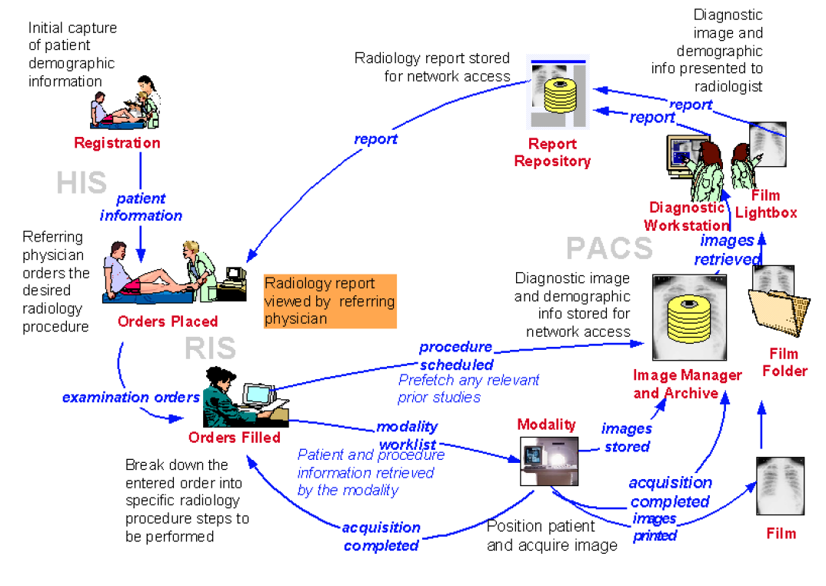
The problem

Slide 3
Non Functional Requirements
(6) Written in Java
(1) GUI in FXML
(3) Have Alerts in a notification panel
(4) System to check for resource conflicts before allocation
(5) Save images as jpg
(7) Local Database in SQL
(9) Have an easy to use GUI
(8) System must provide a visible Schedule list
-list of currently scheduled tasks/procedures

Slide 4
Functional Requirements
Patient Info
Capture current patient demographics
System should have patient search and autofill capabilities to ease updating returning patient demographics
Radiology procedure Order and scheduling
Can order radiology procedure as a referring MD
System can either automatically schedule modality procedure at earliest convince or provide a pending list for receptionist to choose procedure schedule time
System must prevent over-booking of modality resources
System must notify of scheduling errors and provide scheduling conflict resolution if scheduled by receptionist
System should only schedule radiology procedures of patient for current day (Current Scope)
At procedure request the system display medical conflict Warnings
Procedure Breakdown
System must break down requested radiology procedure into procedure steps.
Modality machines must have access to created procedure steps.
System must pre-fetch Patient's previous modality studies and have them readily available for radiologist viewing at diagnostic workstation.

Slide 5
Functional Requirements Continued
Image Taking and Saving
System must get confirmation to continue procedure from modality technician to ward off medical flags
System must be able to take modality images of patient (Select image(s) from file browser)
System must store and manage patient modality images
WorkStation Functionality
System must retrieve Patient modality images from database for radiologist viewing
System must provide a workspace for radiologist to review patient modality Images and write radiologist report
Report Repository
System must save reports written by radiologists into a report repository
System must have a report repository for network access
System must manage who has access to reports based on role and ID
System must have the option to print radiologist report
The system must have a Referring physician portal for report viewing
Charge Capture
The system must capture charges based on resources used

Slide 6
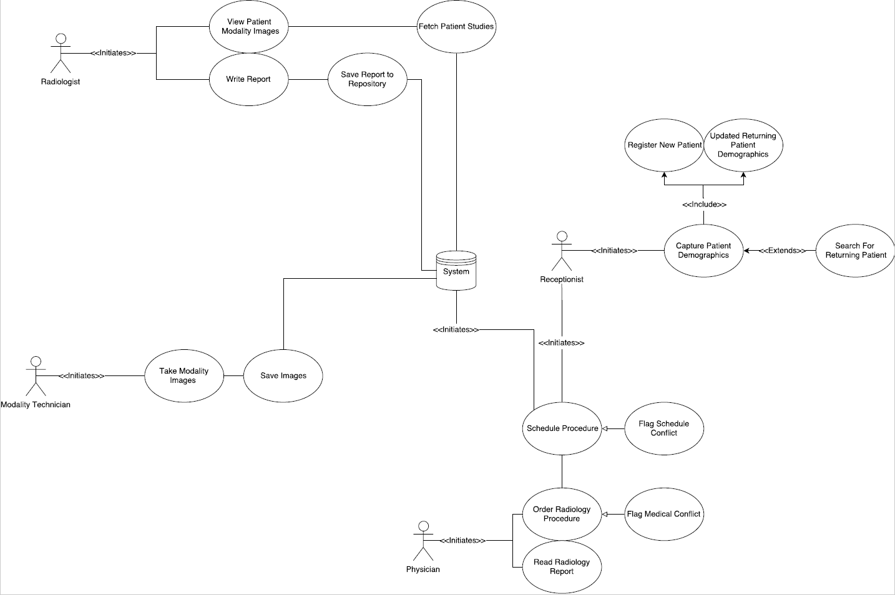
Use Case Diagram

Slide 7
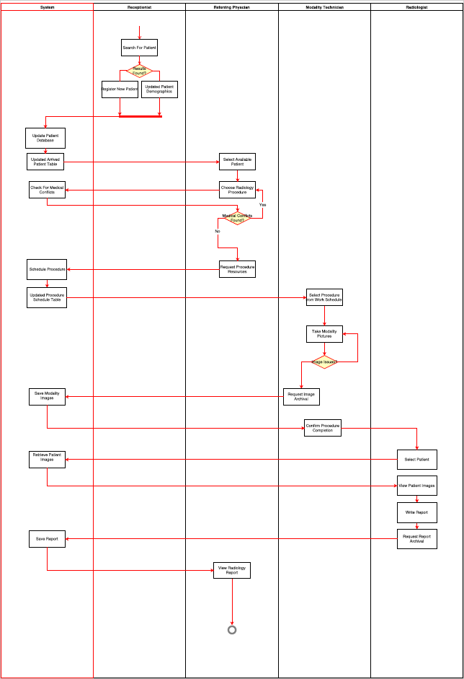
Activity Diagram

Slide 8
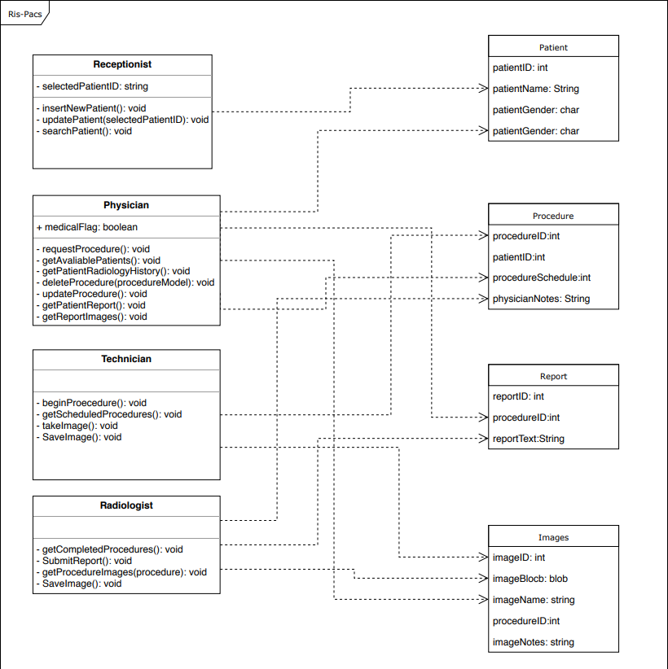
Class Diagram

Slide 9
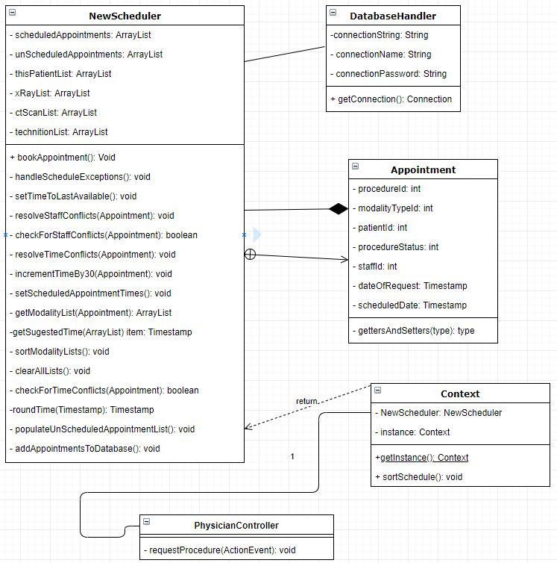
NewScheduler Class Diagram

Slide 10
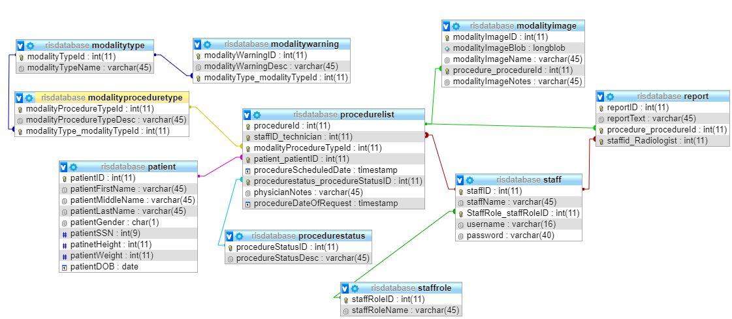
Database Design
3 NF

Slide 11
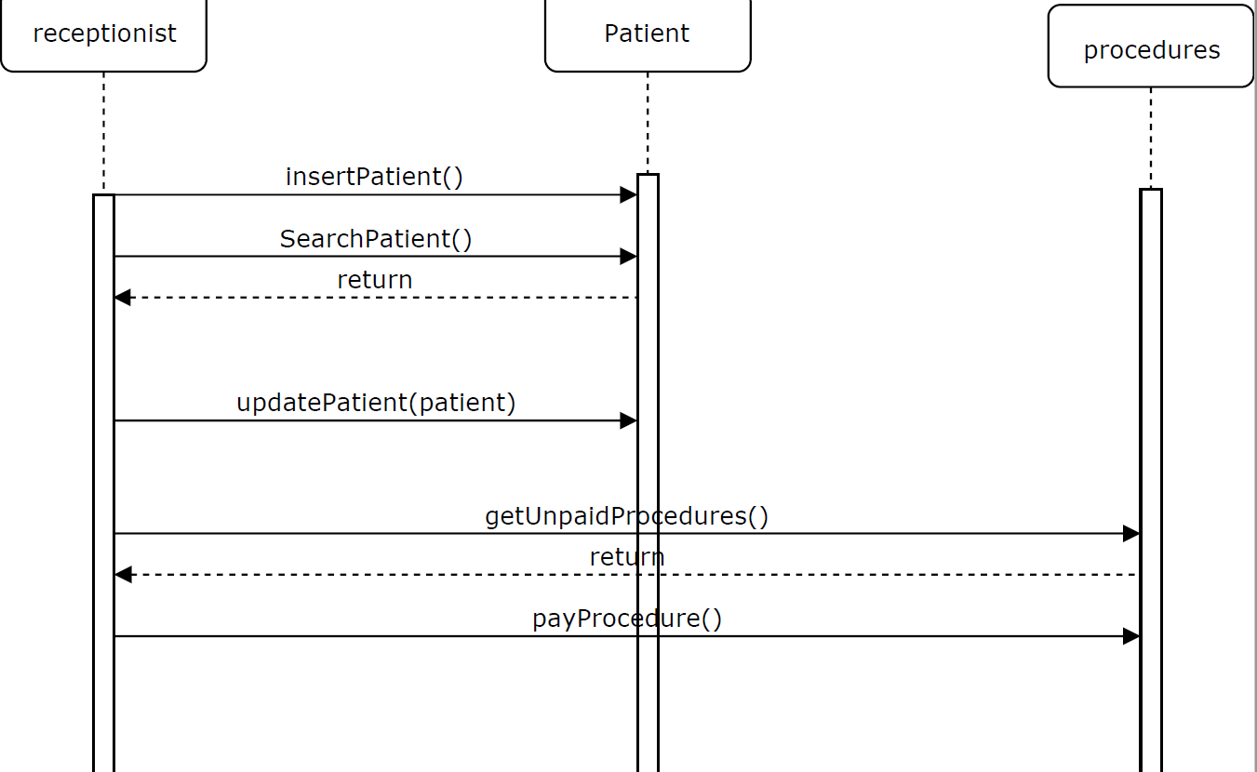
Receptionist Sequence

Slide 12
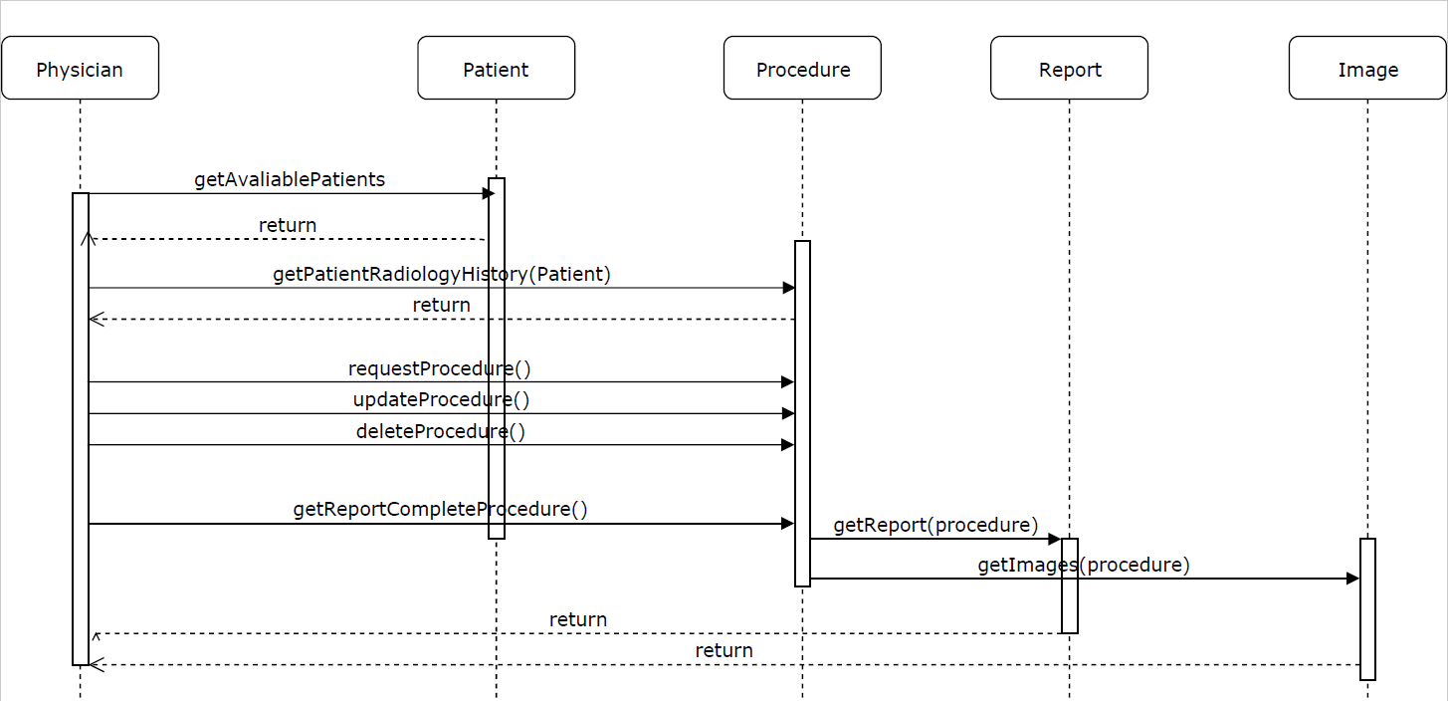
Physician Sequence

Slide 13
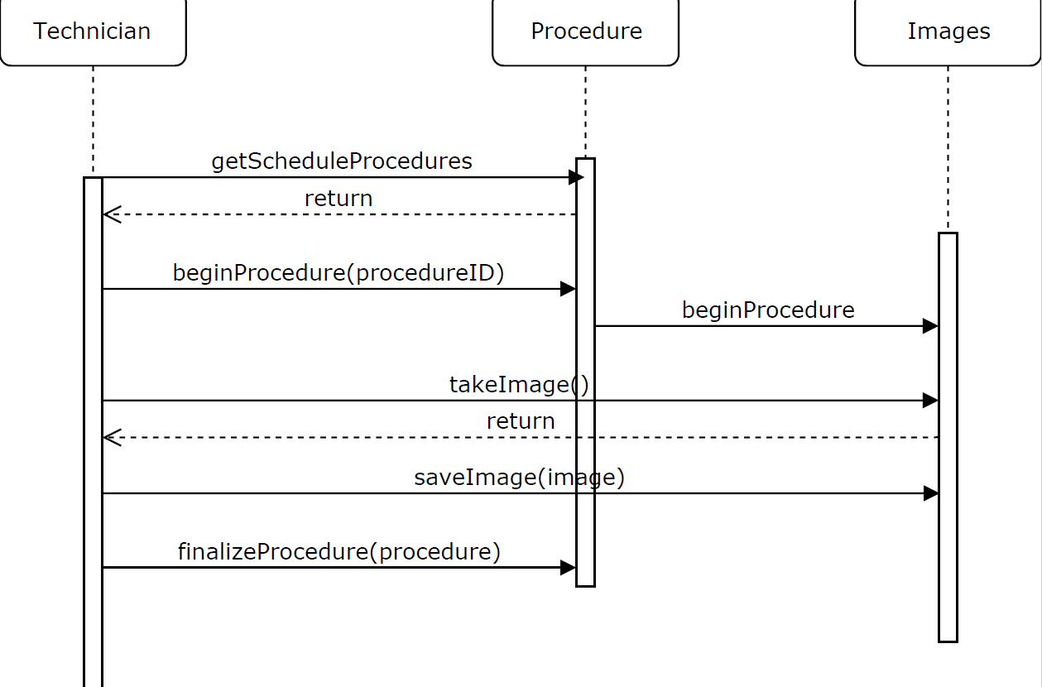
Modality Technician Sequence

Slide 14
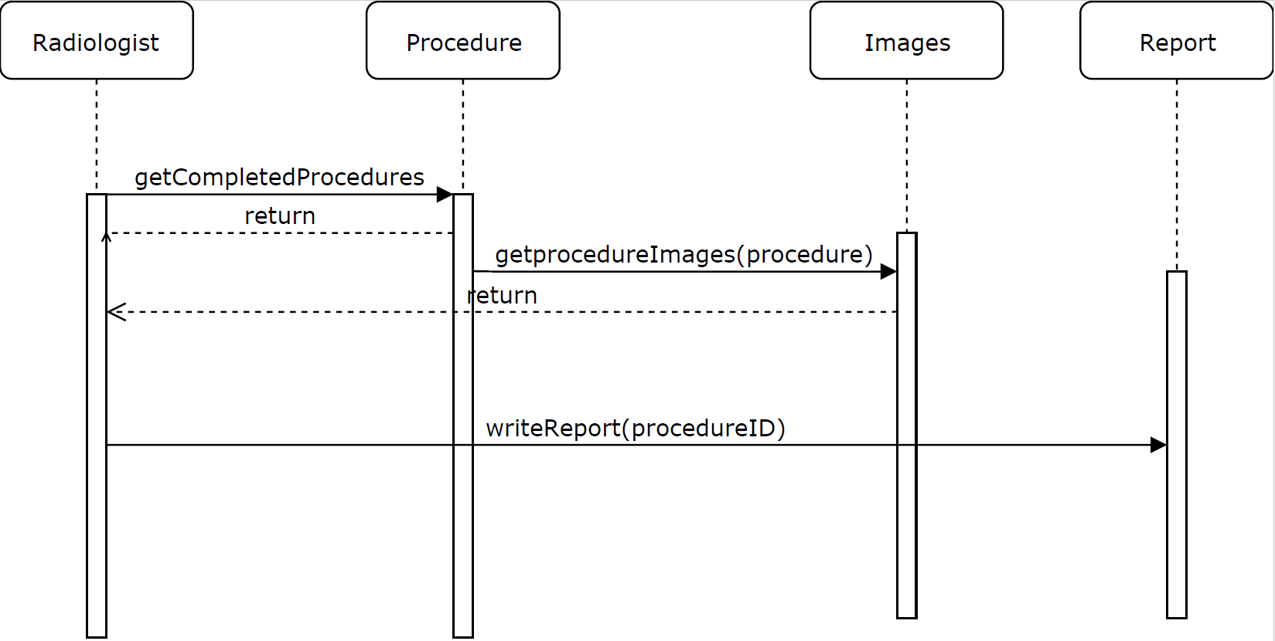
Radiologist Sequence

Slide 15
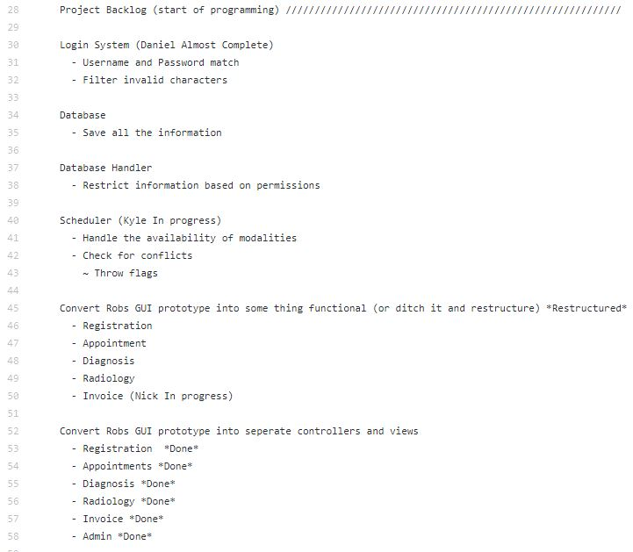
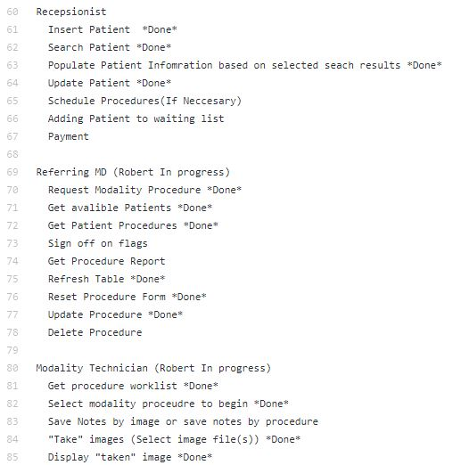
Backlog
How we kept track of who was doing what.
The requirements were divided into tasks.
Developers self selected tasks from the backlog to complete
Tasks with higher priority had to be done first

